Slide 1

NeighbourNet: Connecting Communities for a Better Tomorrow
Let’s build a platform that empowers communities and bridges gaps.
Shubham Saurav (1MS23MC099)
Saathvik N Sharma (1MS23MC084)
Rehan Sheriff (1MS23MC081)

Slide 2
Background
Digital platforms like Nextdoor and Facebook Groups fail to address the fundamental needs of local communities.
These platforms often overwhelm users with excessive features or lack simplicity and inclusivity.
Many individuals, particularly those with disabilities and low-income groups, face barriers in accessing opportunities or engaging effectively in their communities.
This highlights the need for an inclusive, streamlined platform for neighborhood interaction.

Slide 3
A Need for Inclusive Digital Neighborhoods
Existing digital platforms are inaccessible to people with disabilities and fail to provide a user-friendly, privacy-focused environment for low-income groups to connect and access resources.
There is no platform designed explicitly for simplifying and enhancing core neighborhood interactions while ensuring accessibility and privacy.
Idea: To develop NeighbourNet, an inclusive and secure web platform for fostering local connections, offering help requests, resource sharing, and meaningful community engagement

Slide 4
Key Goals of NeighbourNet
Develop
Develop an intuitive and accessible platform for seamless community engagement.
Provide
Provide robust features like help requests and resource sharing to address key community needs.
Ensure
Ensure platform accessibility through ARIA roles and design for inclusivity across all devices.
Promote
Promote stronger neighborhood connections through a simplified and privacy-focused interface.

Slide 5
Defining the Reach of NeighbourNet
Primary Focus:
Enhancing neighborhood connectivity.
Providing tools for help requests and resource sharing.
Target Audience:
Individuals with disabilities.
Low-income groups.
Anyone seeking a better platform for community interaction.
Potential Expansion:
Add gamification to encourage engagement.
Mobile app development for broader accessibility.
AI-based recommendations for resources and local help.

Slide 6
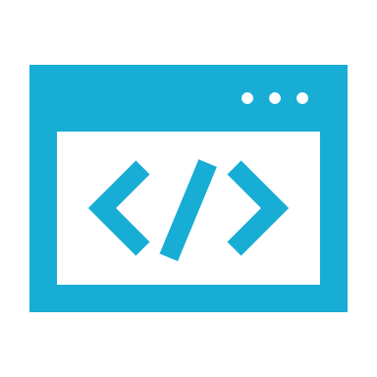
Essential Building Blocks for NeighbourNet
Frontend:
Built with React.js for responsive and user-friendly design.
Material-UI for consistency and accessibility.
Backend:
Node.js with Express for a scalable and fast API.
Database:
MongoDB for efficient data management.
Testing:
Jest, Selenium, Lighthouse

Slide 7
Empowering Communities with NeighbourNet
NeighbourNet aims to bridge the gap in digital inclusivity, empowering communities to interact, share resources, and offer help.
It provides a secure, accessible, and privacy-focused platform tailored to essential neighborhood activities.
By simplifying local interactions and ensuring inclusivity, NeighbourNet has the potential to redefine how communities connect and support each other

Slide 8
Thank You

